Slide 1
UW VISA BASICS 2
Process and Tools
November 05, 2025

Slide 2
AGENDA
Introduction
J Visa Requests
Before You Submit
J Supporting Documents
DS-2019 and After
Q & A
H Visa Requests
Before You Submit
H Supporting Documents
Adjudication Process and After
Q & A
Tips for Success
Q&A
Notes:
Note: training slides will be posted to the Training Resources Archive on the APF website within 2 weeks. No email of the slides is sent out.

Slide 3
INTRODUCTION
Notes:
UEO

Slide 4
VISA REQUEST PROCESSES (GENERALLY)
Pre-Request
Visa Request
Post-Request
Unit gathers sponsorship information on the Visa Intake Form along with supporting documentation
Unit discusses any uncertainties with ISO
Unit then uses information from Visa Intake Form to submit Visa Request Form online
ISO reviews* Visa Request Form and contacts unit with any questions
ISO then sends a PDF of the approved Visa Request
*Review may include gathering documents to confirm visa or appointment eligibility.
Unit gathers any additional supporting documentation
Units gets signatures on approved Visa Request
Unit returns approved Visa Request, with supporting documentation, to ISO for further processing
ISO initiates next steps with various government agencies
Notes:
UEO

Slide 5
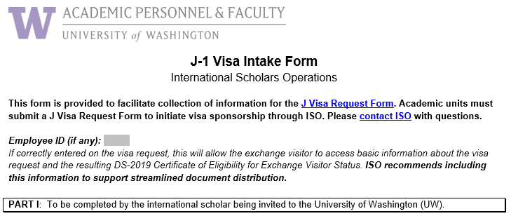
VISA INTAKE FORM
Part I gathers biographic and funding information from the scholar.
Part II gathers appointment information from the appointing unit.
For J-1s: https://ap.washington.edu/j1-intake-2/
For H-1Bs: https://ap.washington.edu/h1b-visa-intake-form/
Notes:
UEO

Slide 6
WHAT IS A VISA REQUEST?
A web form on the Office for Academic Personnel & Faculty (APF) website.
The process by which a UW academic unit initiates UW visa sponsorship for an international scholar.
The process by which APF makes sure that visa sponsorship is (1) feasible and appropriate and (2) consistent with University employment/appointment policies.
One part of the larger process of getting a visa.
Notes:
UEO

Slide 7
WHO SHOULD SUBMIT A VISA REQUEST?
Only someone in the chair’s office or a central business unit with basic knowledge of both visa and appointment issues should submit a visa request, even if anyone with an employee UW NetID can.
Who should not submit:
The international scholar
The faculty sponsor
An outside third party
Notes:
UEO

Slide 8
VISA REQUEST FORM
Sections:
Purpose of Form
Section One - Biographic Information
Section Two - Dependents
Section Three - Appointment Information
Section Four - Funding Information
Section Five - Sponsoring Department/Program Information
Section Six – UW Financial Information
Did you know? The visa request tool (Lux) lets you save draft visa requests (without attachments) for up to 30 days.
Notes:
UEO

Slide 9
WHO LOOKS AT A VISA REQUEST?
ISO advisors review for visa issues
For academic personnel positions, ISO advisors review for appointment issues
Export Control in the Office of Research reviews for deemed export issues (country of origin, grant funding, controlled technology)
This is why you may get emails from different people about the same visa request!
Notes:
UEO

Slide 10
VISA REQUEST PACKET
Once review is complete, ISO will email you a PDF of the approved visa request.
The approved visa request must be routed for signatures and sent back to ISO along with the relevant supporting documentation from the checklist.
Send the entire packet back to ISO by:
Campus mail to Box 351245
Dropping off in our drop box outside 400 Gerberding
Email, as a single PDF, in reply to the conditional approval email
Upload, as a single PDF, to the visa request “Manage Files” page in Lux
Notes:
UEO

Slide 11
THINGS TO REMEMBER
A visa request is not the end product. ISO must process further before the visa is in place.
A visa request requires supporting documents. Checklists of supporting documents for each visa type are on our website.
A visa request is not your only way to get answers. ISO advisors will happily discuss visa eligibility and sponsorship procedures with you, with or without a visa request.
Notes:
UEO

Slide 12
J VISA REQUESTS
Notes:
HS

Slide 13
BEFORE YOU SUBMIT A J VISA REQUEST
You should have collected the following:
Offer or reappointment letter
Biographic page(s) of passport(s)
Documentation of funding
Documentation of English proficiency
Information for the visa request, usually on the J-1 Visa Intake Form
Notes:
HS

Slide 14
WHAT DO WE REVIEW J VISA REQUESTS FOR?
We review for visa considerations:
Is the start date achievable?
Does the funding meet our J-1 funding minimums?
Is the person eligible for J-1 status through the requested end date?
Are the cultural exchange plans sufficient?
We also review for the appointment:
Is the person eligible for the title through the requested end date?
Does the funding meet the salary minimum?
Notes:
HS – Call out that funding minimums depend on # of dependents; that we check to confirm # of dependents.

Slide 15
J-1 SUPPORTING DOCUMENTS
ISO requires supporting documentation with each signed J Visa Request, including but not limited to:
Copies of biographic pages for J-1 and all J-2 dependents
The offer or reappointment letter
Funding documentation
Documentation of English proficiency (new or transfer only)
Patient care letter for foreign medical graduates
ISO can only issue the DS-2019 once we have all supporting documentation.
See our
J-1 Checklist
Notes:
HS – mention that J-1 Checklist is for all J visa requests, not just new J visa requests.

Slide 16
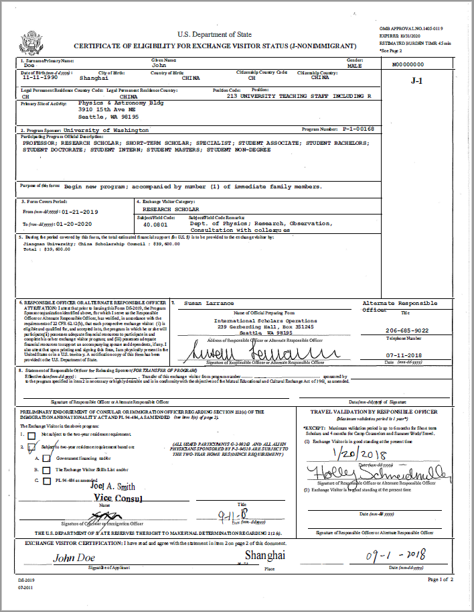
DS-2019 CERTIFICATE OF ELIGIBILITY
ISO uploads Form DS-2019 “Certificate of Eligibility for Exchange Visitor Status” to Manage Files page of visa request
Department forwards DS-2019 to exchange visitor
Exchange visitor prints double-sided, uses DS-2019 to apply for J visa at consulate and uses it to enter U.S.
Notes:
HS – Since January 1, 2025 ISO no longer sends hardcopy DS-2019 documents. All documents are uploaded to the Manage Files section of the visa request when completed.

Slide 17
BEYOND INITIAL J VISA REQUESTS
A new J Visa Request, with appropriate supporting documentation, is needed to do the following:
Extend the person’s J-1 status
Change the person’s appointment title
Move a J-1 already at UW to your department
Transfer a J-1 already at another program sponsor to UW
You should also use Lux to
Amend sponsorship dates using the J1 Amendment Form
Add dependents using the Add J2 Dependent Form
Ask us how much time we need, or just submit as early as you can!
Notes:
HS – mention that transfers-out are a separate process.

Slide 18
Q&A
Q: Are documents for J-1 English Proficiency required for J-1 extension visa requests? Do we need to submit this documentation again?
ISO doesn’t require English Proficiency documentation for J visa extension requests, but we do need English Proficiency documentation for all initial and transfer-in visa requests.
Q: Will this training cover J-1 waivers and, if not, will you provide this information in a future training?
Please reach out to ISO for more information on waivers of the 212(e) two-year home residence requirement.

Slide 19
H VISA REQUESTS
Notes:
UEO

Slide 20
BEFORE YOU SUBMIT AN H VISA REQUEST
You should have collected the following:
Offer or reappointment letter
Information for the visa request, usually on the H-1B Visa Intake Form
For non-CBA titles, a completed Prevailing Wage Intake Form
For staff titles
For Research Scientist Engineers, UWHires or Workday position
For all other titles, a completed rubric from UWHR
Units should wait to assemble other supporting documents until after the visa request has been approved by APF.
Notes:
UEO

Slide 21
WHAT WE LOOK FOR IN H VISA REQUESTS
We review for visa considerations:
Does the person have another status they should exhaust first?
Is the person eligible for H-1B status through the requested end date?
Is the appointment or job eligible for H-1B sponsorship?
Is the salary higher than the likely prevailing wage?
Is the start date achievable?
For academic personnel positions, we also review for:
Is the person eligible for the title through the requested end date?
Does the salary meet the salary minimum?
Notes:
UEO

Slide 22
H SUPPORTING DOCUMENTS
ISO requires supporting documentation with each signed H Visa Request, including but not limited to:
Wage documentation
Documentation of the scholar’s visa status
Documentation of the scholar’s credentials
Filing fee payment
However, ISO can often initiate certain processes without having all documents on hand.
Feel free to ask us what we need right away and what can wait.
See our
H-1B Checklist
Notes:
UEO

Slide 23
ADJUDICATION PROCESS
ISO performs initial review and prevailing wage self-determination, requests any missing documents
ISO has the host department post the Labor Condition Application, then submits it to the DOL
DOL approves the Labor Condition Application
1 week
ISO prepares and files the I-129 Petition with U.S. Citizenship and Immigration Services (USCIS)
*With payment of $2,805 Premium Processing Fee to USCIS
USCIS reviews and approves I-129 Petition
2 weeks* to 12 months
Scholar applies for H-1B visa at U.S. consulate and enters U.S.
1 week to 2+ months
Notes:
UEO: walk through graphic, call out particular delays at consulates; Remember to mention that government processing times are largely not amenable to change by ISO

Slide 24
USCIS FEES FOR H-1BS
Anywhere from $460 to $3765, depending on case type and urgency
Must be paid by unit
Can only be paid with G-1450 Credit Card Authorization Form(s) using a UW ProCard
More information and instructions are available on the APF Visa Fees page.
Notes:
UEO: Emphasize the importance of making sure the scholar name or visa request ticket number is listed on the checks when they come to ISO to avoid delays in processing.

Slide 25
BEYOND INITIAL H VISA REQUESTS
You must submit a new H Visa Request, with supporting documentation, to do any of the following:
Extend the person’s H-1B status
Change the person’s appointment title
Move an H-1B already at UW to your department
Transfer an H-1B already in the U.S. to UW
Submit as early as you can but remember that ISO recommends at least four months of lead time, even with USCIS premium processing.
Notes:
UEO: call out that no action necessary for H-1B transfers-out.

Slide 26
Q&A
Q: What is the average H-1B extension processing time without premium processing?
USCIS is currently taking around 6.5 months for H-1B extensions without premium processing.
Q: Should we still await news about the $100K H-1B fee before considering whether another visa type might be possible, such as a J-1, if the scholar is already here in the U.S.?
The new fee doesn’t apply to changes of status within the U.S., however there is still an institutional pause, so you could work on the H visa request even if ISO can’t file it yet. This would allow for quicker filing once the pause is lifted.
If the person is coming from outside of the U.S., we will probably need to consider other visa types because the fee will likely apply.

Slide 27
TIPS FOR SUCCESS
Notes:
HS

Slide 28
REMEMBER THE DIFFERENCES
 | J-1 | H-1B
Lead time | At least three months | At least four months
When to collect documents | Before submitting visa request | Once visa request is approved
Orientation | Must request remote check-in from ISO | No check-in required, but optional orientation available
Costs | No filing fees; no premium processing; $220 SEVIS fee for new J-1s | Filing fees up to $3,765; unit must pay fees
Notes:
HS

Slide 29
RESOURCES
How to Sponsor | J-1 | H-1B
Intake Form | J-1 | H-1B
Visa Request Form | J-1 | H-1B
Checklist | J-1 | H-1B
Scholar Resources | J-1 | H-1B
See UWHR
guidelines for staff visa sponsorship
Department of State Visa Appointment Wait Times
Notes:
HS

Slide 30
HOW TO DO LESS WORK ON J VISA REQUESTS
Submit as soon as possible (at least three months in advance for new J-1s)
Gather all supporting documents before you submit
Confirm number of dependents with scholar
Submit visa request with all required supporting documents as soon as possible
Don’t submit supporting documents that aren’t required
If possible, forward the scanned DS-2019 rather than express-mailing the print DS-2019
Notes:
HS – on processing time, “as soon as possible, but note that you may have to push out start dates”

Slide 31
HOW TO DO LESS WORK ON H VISA REQUESTS
Work with UWHR early for staff visa sponsorship requests
Submit as soon as possible (at least four months in advance WITH premium processing)
Confirm number of dependents with scholar
Ensure information on visa request and supporting documents match
Set realistic expectations with scholar and faculty
Wait to provide USCIS fees until instructed by advisor
Follow our Tips on Completing Form G-1450 for USCIS fees
Pay $2,805 USCIS premium processing fee, where possible
Notes:
HS - mention that premium processing is recommended for postdoctoral scholar H-1Bs

Slide 32
THANK YOU!
https://ap.washington.edu/ahr/visas/
acadvisa@uw.edu
Notes:
HS & UEO ask if there are any questions at the end of the presentation.

