Slide 1
UW Visa Basics 1
Overview – Visa Types
10/15/2025
Notes:
UEO

Slide 2
TODAY’S TOPICS
Introduction to UW Visas
J-1 Exchange Visitors
H-1B Temporary Workers
TN Canadian & Mexican Professionals
E-3 Australian Professionals
F-1 & J-1 Student Trainees
EADs & LPRs
Resources & Q&A
Notes:
UEO : (1) Who is new to their role?, (2) Who has attended this training before?

Slide 3
BEFORE WE BEGIN…
    Not everyone needs visa sponsorship
    Not everyone is eligible for visa sponsorship
    Not all appointments/employment relationships qualify for visa sponsorship
    If sponsorship is needed, APF chooses the visa type
    All UW-sponsored visas are processed by UW
    If you have visa questions, you can always contact ISO
Notes:
NS

Slide 4
IS VISA SPONSORSHIP NEEDED?
  You may ask:
  “Are you legally authorized to work in the U.S?”
  “Can you provide evidence within three business days after the start date that you are eligible to work in the U.S?”
  “Will you now or in the future require UW sponsorship for a visa or permanent residence?”
  Don’t promise a visa or permanent residence—agree only to consider for possible sponsorship of a visa in accordance with UW policy
Notes:
NS

Slide 5
Sponsored vs. Non-sponsored Visas
Sponsored by UW through ISO:
J-1 Exchange Visitor
H-1B Temporary Worker
TN and E-3 Treaty Workers
O-1A Extraordinary Ability
Legal Permanent Residence for some faculty members
Sponsored by schools (UW or other):
F-1 Optional Practical Trainees
J-1 Academic Trainees
Non-sponsored:
EAD Holders
Legal Permanent Residents
Notes:
NS

Slide 6
VISA ELIGIBILITY CAN DEPEND UPON:
          Scholar:
            Country of origin
            Whether they’re in the U.S.
            Current visa status
            Previous visa history
            Highest degree
            Source of funding
          Employment/Appointment:
            Academic personnel or staff
            Track
            Minimum requirements
            Paid or unpaid
            FTE
            Duties
UW sponsors visas for full-time academic personnel titles, and full-time permanent staff titles identified by UWHR.
Notes:
NS

Slide 7
VISA REQUEST PROCESS
Unit submits visa request form to APF
ISO reviews, issues conditional approval to unit
Unit submits visa request packet to ISO
ISO processes visa with relevant government agencies
Come to our
UW Visa Basics 2 training on November 5 for more process information!
Notes:
NS

Slide 8
J-1 EXCHANGE VISITORS
Notes:
NS: Raise your hand if you’ve dealt with this visa type before?

Slide 9
What is a J-1?
Exchange Visitor in the U.S. to engage in academic exchange through research, teaching, observation, consultation, or demonstration of special skills.
Must be sponsored by designated J-1 program sponsor, who administers their record through the Student and Exchange Visitor Information System (SEVIS).
More information about J-1 Exchange Visitors
Notes:
NS

Slide 10
Eligible Titles
Postdoctoral Scholar
Acting Instructor
Acting Assistant Professor
Visiting titles
Tenured or tenure-track employment not allowed
Clinical titles or duties not allowed
Not compatible with permanent residence sponsorship or staff employment
Notes:
NS

Slide 11
UNIQUE FEATURES OF J-1 STATUS
Expectation of return to home country
J-1s must have:
  Health insurance
  English proficiency
  Adequate funding
  Cultural exchange plans
Easy and quick to issue, update, extend
No USCIS processing times or filing fees
J-2 dependent may apply for work authorization
Notes:
NS

Slide 12
LIMITATIONS OF J-1 STATUS
Sponsor-, activity-, category- & location-specific
No reductions in FTE or salary
Payment for outside activities permitted only if authorized by ISO in advance
Absences from U.S. of 30+ days should be reported to ISO if scholar has
  Approved International Remote Work Request from the Office of Global Affairs
  Approved protected leave request from APF
Notes:
NS: Call out that IRWR approval process is changing and moving to Global Operations Support sometime this year; more information will be sent to campus as it becomes available

Slide 13
LIMITATIONS OF J-1 STATUS - Time
New/arriving J-1 exchange visitors must
  Arrive to the U.S. on or before DS-2019 start date
  Check in with ISO within 30 days of DS-2019 start date
Period of stay: up to 5 years
12 & 24 month bars on repeat participation in some J-1 categories
Possible 2-year home residence requirement (“212(e)”) preventing change of status or return to U.S. on H, L, or permanent resident visas (212(e))
Notes:
NS: Does anyone have any questions about this visa type?

Slide 14
H-1B SKILLED WORKERS
Notes:
UEO: Raise your hand if you’ve dealt with this visa type before.

Slide 15
WHAT IS AN H-1B?
“Temporary Worker in a Specialty Occupation” requiring a post-secondary degree
Must be sponsored by a specific employer, and the terms and conditions of their employment must be reported to the Department of Labor (DOL) and to U.S. Citizenship and Immigration Services (USCIS)
More information on H-1B temporary workers
Notes:
UEO

Slide 16
H-1B Eligible titles
Postdoctoral Scholars (if currently in the U.S.)
    F-1 OPT or J-1 holders must exhaust that eligibility before changing status to H-1B
Acting Instructors
Professorial appointments, all tracks
Residents/Fellows (subject to GME Visa Policy)
Fellows – Non-ACGME
Lecturers Full-Time Temporary
Permanent, full-time staff titles identified by UWHR
    F-1 OPT must exhaust that eligibility before changing status to H-1B
Notes:
UEO

Slide 17
UNIQUE FEATURES OF H-1B STATUS
Primary purpose is employment
Position must:
  Require bachelor’s degree or higher in a relevant field
  Pay salary at or above both “prevailing wage” (paid to similar workers in greater Seattle area, based on Department of Labor data) and “actual wage” (paid to similar workers at UW)
USCIS filing fees of up to $3765*
USCIS processing times without “premium processing” can take 3-12 months
H-4 spouse may seek employment authorization in limited circumstances
Notes:
UEO

Slide 18
WHAT ABOUT THE NEW H-1B FEE?
The president recently announced a new $100,000 fee on all new H-1Bs
Applies to new H-1Bs coming from outside the U.S.
ISO is working on strategies for affected cases
See New H-1B Visa Fee Updates for more information

Slide 19
Limitations of H-1B Status
Employer-, title- & location-specific
No reductions in FTE or salary
No outside employment permitted
Early termination requires that the sponsoring unit pay the “reasonable costs of return transportation”
Period of stay: up to 3 years, renewable for total of 6 years (with some exceptions)
Notes:
UEO:

Slide 20
Q & A
Q: Do we need to report when an H-1B visa holder's pay goes up?
A: No, that change does not require reporting.
Q: If an H-1B scholar goes through a title change (for example, promotion), does that need to be reported to ISO? If so, what sort of changes need to be done to their visa?
A: In general a title change (including a promotion) requires a new H visa request to ISO and a new H-1B petition to USCIS. One benefit with filing this petition is that we can extend the H-1B based on the end date of the new appointment.

Slide 21
TN CANADIAN & MEXICAN PROFESSIONALS
Notes:
UEO: Raise your hand if you’ve dealt with this visa type before?

Slide 22
WHAT IS A TN?
A Canadian or Mexican national entering as a professional under the U.S./Mexico/Canada Agreement (formerly NAFTA).
Can be processed directly at the border (for Canadians) or the U.S. consulate (for Mexicans) OR filed with USCIS.
Filing with USCIS requires a visa request to ISO, but processing at the border or consulate does not.
More information on TN professional workers
Notes:
UEO

Slide 23
TN Eligible Titles
No “dual intent” (not compatible with permanent residence, so not appropriate for professorial appointments)
Best for temporary appointments:
  Postdoctoral Scholar
  Acting Instructor
  Lecturer Full-Time Temporary
  Acting Assistant Professor
Also used for many staff titles
Doesn’t allow physician patient care
Notes:
UEO

Slide 24
UNIQUE FEATURES OF TN STATUS
TN status is employer- and job-specific
Does not require a prevailing wage determination or Labor Condition Application
Does not require a petition to USCIS or USCIS filing fees
(except in-country changes of status or extensions)
Position must be a USMCA Occupation
Period of stay: Up to 3 years, renewable indefinitely
TD spouse not eligible for work authorization
Notes:
UEO: Does anyone have any questions about this visa type?

Slide 25
E-3 Australian Professionals
Notes:
UEO:

Slide 26
WHAT IS AN E-3?
An “Australian Treaty Worker” requiring a post-secondary degree.
A lot like H-1Bs: Must be sponsored by a specific employer, and terms and conditions of employment must be reported to the DOL and (sometimes) USCIS
More information on E-3 treaty workers
Notes:
UEO

Slide 27
E-3 ELIGIBLE TITLES
No “dual intent” (not compatible with permanent residence, so not appropriate for professorial appointments)
Best for temporary appointments:
  Postdoctoral Scholar
  Acting Instructor
  Lecturer Full-Time Temporary
  Acting Assistant Professor
Permanent, full-time staff titles identified by UWHR
Notes:
UEO

Slide 28
UNIQUE FEATURES OF E-3 STATUS
E-3 status is employer, location- and job-specific
Requires Labor Condition Application, but no petition to USCIS
(except in-country changes of status or extensions)
Can be processed at U.S. consulate abroad instead of through USCIS
Period of stay: Up to 2 years, renewable indefinitely
E-3D spouse may apply for work permit
Change of employer is harder with E-3 than with H-1B
Notes:
UEO: Does anyone have any questions about this visa type?

Slide 29
O-1A EXTRAORDINARY ABILITY

Slide 30
WHAT IS AN O-1A?
A visa type for persons with “extraordinary ability in the sciences, education, business, or athletics, which has been demonstrated by sustained national or international acclaim”
Only for professorial faculty
Generally sponsored by rare exception only
Must be processed by or through ISO (at $102/hour fee)

Slide 31
WHAT ABOUT THE PILOT PROGRAM?
ISO is working with an outside firm on a pilot program to better support/expand O-1A sponsorship
Attorney’s + filing fees would be at least $11,000 and must be paid by unit
Email acadvisa@uw.edu for more information if you’re interested

Slide 32
F-1 & J-1 STUDENT TRAINEES
Notes:
UEO: Raise your hand if you’ve dealt with an F-1 or J-1 trainee before?

Slide 33
ELIGIBLE TITLES FOR TRAINEES
No “dual intent” (not compatible with permanent residence, so not appropriate for professorial appointments)
Best for temporary appointments:
  Postdoctoral Scholar
  Acting Instructor
  Lecturer Full-Time Temporary
  Acting Assistant Professor
Also compatible with staff employment
REMEMBER:
Professorial ranks should change to H-1B as quickly as possible
All other employees should exhaust trainee eligibility before changing
to H-1B
More information on F-1 and J-1 Trainees
Notes:
UEO

Slide 34
UNIQUE FEATURES OF F-1
“OPTIONAL PRACTICAL TRAINING”
Available to F-1 students graduating from U.S. schools
Processed through international students office and USCIS, NOT ISO
Initial OPT up to 12 months; STEM OPT up to another 24 months
Evidence of OPT is an EAD card
Employment must provide training in the student’s field of study
For STEM OPT, employer must complete an I-983 Training Plan
Notes:
UEO

Slide 35
UNIQUE FEATURES OF
J-1 “ACADEMIC TRAINING”
Available to J-1 students graduating from U.S. schools
Processed through international students office and SEVIS, NOT ISO
Evidence of AT is a modified DS-2019 and letter from the school
Academic Training is not processed through USCIS; students do not receive an EAD card
Initial academic training up to 18 months; postdoctoral academic training up to an additional 18 months
Does not allow clinical activities
Notes:
UEO

Slide 36
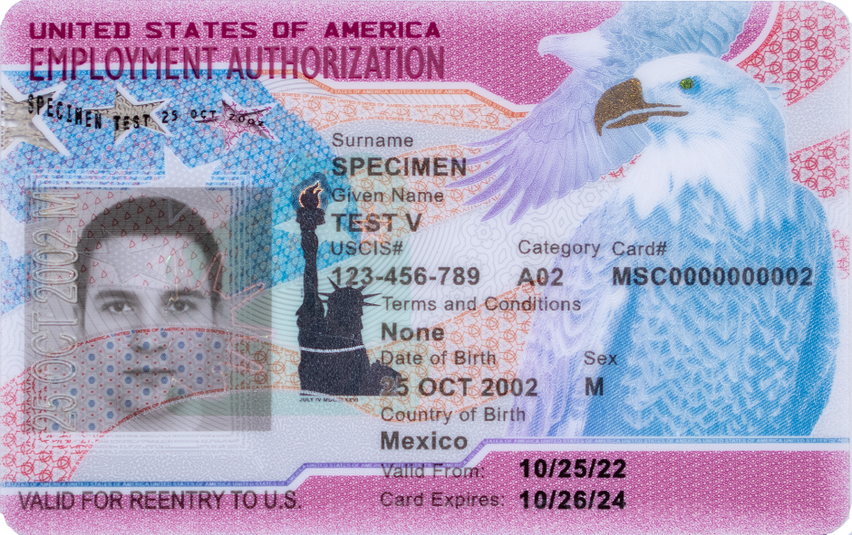
EMPLOYMENT AUTHORIZATION DOCUMENTS (EADs)
Certain foreign nationals may apply for an EAD
Most EADs provide unlimited employment authorization within the validity dates on the card
EAD holders may include, but are not limited to:
  Asylees/refugees
  Temporary Protected Status (TPS)
  J-2 dependents of J-1 Exchange Visitors
  Applicants for adjustment of status
  Many other classifications
Notes:
UEO

Slide 37
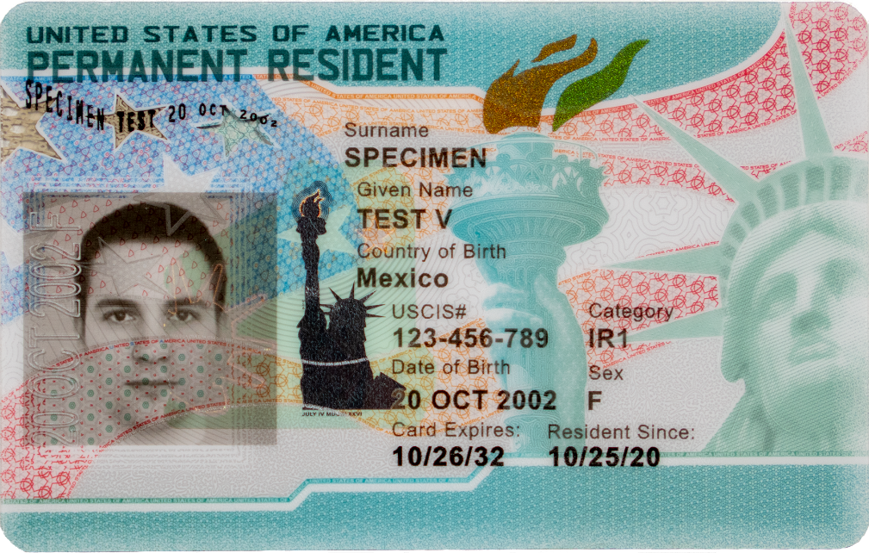
PERMANENT RESIDENCE
UW sponsors most professorial faculty for permanent residence
Once approved, permanent residence is documented by a “green card”
Provides unlimited authorization to work in the U.S. in position or field of choosing
If ISO receives visa request for a position eligible for permanent residence sponsorship, we will contact you to start the process.
Notes:
UEO

Slide 38
O-1A &
EB-1B
Q & A
Q: What is the difference between the O-1A and EB-1B visas?
A: These are separate visa types:
O-1A is a nonimmigrant visa (that is, a pathway to enter the U.S. and work) for individuals with Extraordinary Ability in the sciences, education, business, or athletics, requiring a showing of “sustained national or international acclaim”.
EB-1B is an immigrant visa (that is, a pathway to legal permanent residence) for Outstanding Researchers or Professors, requiring a showing of “sustained international recognition”.
We are working on adding more information regarding both O-1A and EB-1B sponsorship to our website.

Slide 39
RESOURCES
ISO Visa Guidance for Unit Administrators
Visa content on APF blog
APF Training Resources Archive
UWHR Staff Visa Sponsorship
acadvisa@uw.edu
Notes:
Unmute for questions; promise to mail out slide deck and Q&A to attendees.

