Slide 1
SABBATICAL LEAVE
2024-25
October 19, 2023

Slide 2
What we will cover today:
Purpose
Duration of Sabbatical Leave
Eligibility
Salary Support
Applying for Sabbatical/Submitting Applications
Approvals and Sabbatical Entry
Completion of Leave/Return to Service
FAQs

Slide 3
Purpose of a sabbatical
Outlined in UW Executive Order 33 (for faculty) and UW Libraries Librarian Personnel Code (for librarians)
A release from regular academic duties to focus on research/scholarship and professional development
Enhance capacity for service to the UW
Sabbaticals (aka professional leave with pay) is a privilege, not a guarantee

Slide 4
Duration of leave
Autumn Quarter
9/16 – 12/15
Leaves follow normal academic quarter start/end dates associated with 9-month and 12-month service periods
Summer Quarter
6/16 – 9/15
Winter Quarter
12/16 – 3/15
Spring Quarter
3/16 – 6/15

Slide 5
Eligibility
Tenure, WOT, research, and teaching track faculty are eligible for sabbatical leave, as are librarians with continuing or permanent status.
Academic personnel become eligible for sabbatical no earlier than their seventh year of UW service OR the seventh year after returning from a previous sabbatical.
Someone returning from sabbatical starts accruing time toward their next sabbatical in the academic year following the year they returned from sabbatical leave.
Academic Partners can use the NEW Sabbatical Eligibility Assessment Report R0878 to support internal review.

Slide 6
Eligibility
Year 1: Initial hire
Year 2
Year 3
Year 4
Year 5
Year 6: Can apply for sabbatical
Year 7: If approved, can take sabbatical
Year 0: Was on sabbatical
Year 1
Year 2
Year 3
Year 4
Year 5
Year 6: Can apply for sabbatical
Year 7: If approved, can take sabbatical

Slide 7
POP QUIZ!
A faculty member last took sabbatical in the 2016-17 academic year. In what year are they eligible to take their next sabbatical?
2023-24

Slide 8
Eligibility
Clock-managed assistant professor titles are not eligible for sabbatical leave until they have been reviewed and approved for tenure/promotion:
Assistant Professor Tenure-Track
Assistant Professor WOT
Research Assistant Professor
Assistant Professor-Clinical Dental Pathway

Slide 9
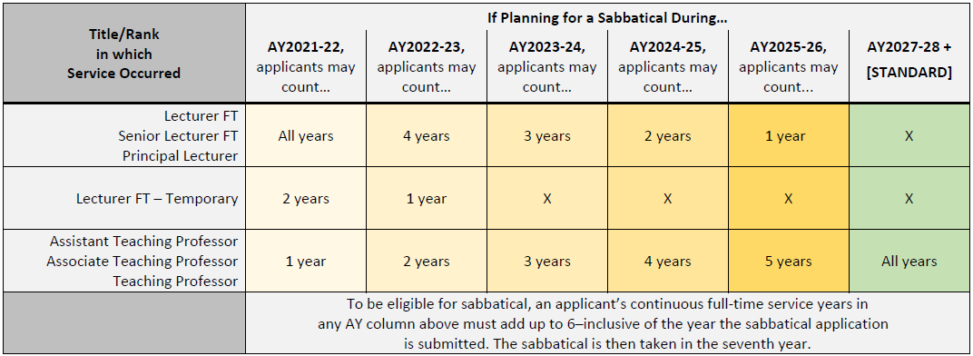
Teaching track and prior service
Faculty who converted to the professorial teaching track are eligible for sabbatical leave according to the phased eligibility chart noted below:

Slide 10
Salary support
Standard levels of sabbatical salary support:
100% salary for a leave of 1 quarter
75% salary for a leave of 2 quarters
67% salary for a leave of a full academic year (i.e., 3 quarters for a 9-month service period, 4 quarters for a 12-month service period)
Faculty may supplement sabbatical salary support, up to their full base salary, with grants, endowment support, or other allowable funding designated for salary purposes.
Faculty who are expected to fund all/part of their appointment shall have no expectation of salary support from the unit.

Slide 11
Salary support
Statutory limit:
State law limits the actual dollar amount of general state and local funds the UW may pay to faculty while on sabbatical.
2024-25 statutory limit: $21,378
A faculty member may use external sources of support to fund the portion of their salary that is subject to the statutory limitation.

Slide 12
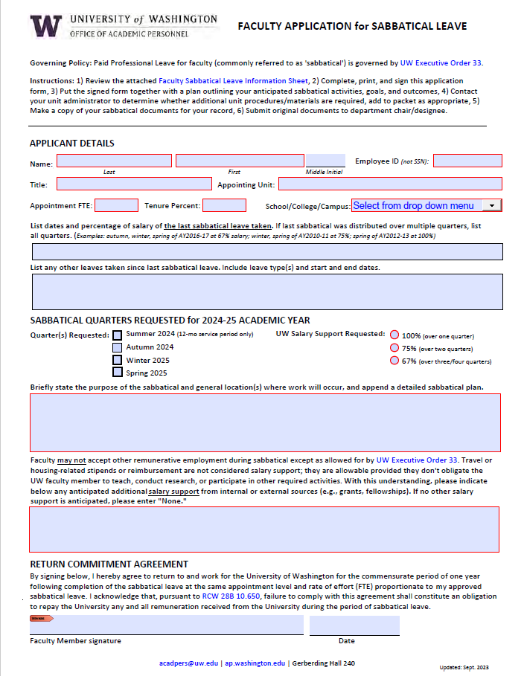
Applying for sabbatical
Applicant submits completed 2024-25 application form, sabbatical plan, and updated CV (and any other unit-required materials) for internal review and routing in accordance with unit-level sabbatical processes.
If there is support for the application, a letter of support is added to the application packet before it is routed to the dean/chancellor.
Application packet content varies between faculty and librarians; be sure to read through requirements at https://ap.washington.edu/ahr/policies/sabbaticals/.

Slide 13
Submitting applications
Application materials should be combined into a single PDF in the following order:
2024-25 Application for Sabbatical Leave
Memorandum/letter of support
Detailed sabbatical plan
CV
Additional materials as appropriate
Please use this file naming convention when submitting sabbatical application PDFs:
<<Employee ID>> <<Lastname>>, <<Firstname>>.pdf
Example: “123456789 Picard, Jean Luc.pdf”

Slide 14
Submitting applications
Dean’s/Chancellor’s offices should download the AY2024-25 spreadsheet template to catalogue all sabbatical requests in each school/college/campus.
A completed copy of the template should be submitted for each S/C/C
Submission Deadline: January 12, 2024

Slide 15
Submitting applications
All materials should be submitted to AHR through SharePoint
Requests to add or remove access to SharePoint should be sent to acadpers@uw.edu from a dean’s/chancellor’s office representative

Slide 16
Notifications & processing
AHR will notify dean’s/chancellor’s offices of sabbatical decisions once institutional review is complete.
Each quarter, AHR sends S/C/C administrators a list of all academic personnel scheduled to go or return from a sabbatical that quarter.
Unit admins enter sabbatical leaves and FTE changes into Workday - there are no mass uploads for this process. See the Leave of Absence - Sabbatical - Academic Personnel ISC user guide for related Workday processes.

Slide 17
Completion of sabbatical leave
Faculty and librarians returning from sabbatical must submit a brief report outlining:
Where the leave was spent
Principal accomplishments, including their application to teaching or research effectiveness (for faculty) and improvement of library services at the UW Libraries (for librarians).
Reports should be sent to APLeaves@uw.edu.

Slide 18
Return to service
Following the sabbatical, the individual must return to service at the appointment percent held prior to sabbatical.
The return-to-service obligation starts in the academic year following the year in which the sabbatical occurred.
Failure to return for the requisite period creates an obligation on the faculty member’s part to repay the University any state and locally funded remuneration received during the sabbatical leave.
This return to service obligation is noted on the application and on OAP’s Sabbatical Leave webpage.

Slide 19
Return to service
Faculty who take a full sabbatical are required to return for a full academic year.
A full sabbatical is any of the following:
1 quarter sabbatical at 100% salary support
2 quarter sabbatical at 75% salary support
3 or 4 quarter sabbatical at 67% salary support
Faculty who take less than a full sabbatical have a prorated return obligation.
Faculty who distribute their sabbatical over multiple years will have their return obligation distributed over multiple years.

Slide 20
Retirements/resignation
When processing faculty terminations, please review the Workday record for recent sabbaticals that might suggest a payback obligation.
Faculty and librarians planning to retire/resign within the next two years may want to consider requesting a leave without pay in lieu of a sabbatical.

Slide 21
Common questions/issues
Can the UW employee be employed by another institution/organization while on sabbatical?
Can a faculty member/librarian make changes to their sabbatical plan after it is approved?
Can WOT and research faculty take sabbaticals?
Can other leaves impact sabbatical eligibility?
Can faculty & librarians continue to perform regular duties for the UW while on sabbatical?

Slide 22
Outside employment/compensation
Q: Can UW academic personnel be employed or be otherwise compensated elsewhere while on sabbatical?
A: No, unless formally approved for outside work.
Faculty/librarians may not accept remunerative employment during sabbatical.
Acceptance of a supplemental grant or fellowship should not carry with it duties or obligations which hinder the pursuit of the purpose for which the sabbatical is granted.
UW personnel can request approval for Outside Work through the UW Office of Research, but the work should be separate and distinct from the sabbatical plan.
Travel or housing-related stipends provided by outside entities are allowable.

Slide 23
Changes to approved sabbaticals
Q: Can a faculty member/librarian make changes to their sabbatical plan after it is approved?
A: Yes
Seek internal support from the school/college/campus (S/C/C) leadership
S/C/C routes request to OAP: APLeaves@uw.edu
Depending on the extent of change, may require updated application

Slide 24
WOT & Research Faculty
Q: Can WOT and research faculty take sabbaticals?
A: Yes, but there may be more logical alternatives.
Faculty who are expected to fund their appointment should have no expectation of sabbatical salary support from their unit.
Units could provide salary support from appropriate sources, but the leave would count against the unit’s allocation of sabbatical quarters.
It makes more sense for the individual to request a temporary adjustment to their regular duties and go on a partial leave of absence without pay; this would not be a considered a sabbatical and would not count against the unit’s sabbatical quarter allocation.

Slide 25
Intervening leaves
Q: Can other leaves impact sabbatical eligibility?
A: Yes
Full or partial unpaid leaves (including outside work) may impact sabbatical leave eligibility.
Generally, if an individual works an average of at least 50% of their roster during the year, that year will count toward their sabbatical accrual; however…
Individuals with extensive leave history may require a more thorough review. Reach out to OAP with questions: APLeaves@uw.edu.

Slide 26
Release from regular duties
Q: Should faculty & librarians continue to perform regular duties while on sabbatical?
A: No
A sabbatical is a release from regular academic duties to focus on research/scholarship and professional development.
Individuals should not continue to perform/be expected to perform regular academic duties while on sabbatical.
Individuals should not continue to perform/be expected to perform administrative duties; ADS should stop during sabbatical

Slide 27
Resources
Sabbatical Leave Website
https://ap.washington.edu/ahr/policies/paid-professional-leave/
Faculty Application for Sabbatical Leave
Faculty-Application-for-2024-25-Sabbatical-Leave.pdf (washington.edu)
Librarian Application for Sabbatical Leave
Librarian-Application-for-2024-25-Sabbatical-Leave.pdf (washington.edu)
Sabbatical Leave ISC User Guide
https://isc.uw.edu/user-guides/loa_sabbatical/

