Slide 1
REAPPOINTMENTS
November 15, 2023

Slide 2
AGENDA
Reappointment Defined
Timelines: Winter & Spring
Steps & Process
Report R0555 & Tips
Manual Entry
Non-Reappointment
Q & A

Slide 3
REAPPOINTMENT DEFINED

Slide 4
REAPPOINTMENT DEFINED (part 1)
Many academic personnel appointed for a fixed term: quarterly, annual, or multiyear. Decision to Reappoint or Non-Reappoint.
Reappointment extends the fixed term end date
Voted on by eligible voting members
Final decisions by the dean/chancellor
ISC EIB mass uploads for annual and multiyear faculty
Unit initiates quarterly faculty and non-faculty academic personnel

Slide 5
REAPPOINTMENT DEFINED (part 2)
What it isn’t…
Not a promotion
Not a change of academic title or rank
Not rehire after break in service
Not clock-managed mandatory review

Slide 6
IMPACTS!
Carefully managed reappointments establish solid foundation for several downstream processes
Directly impacts the hiatus process
Directly impacts the merit process
Directly impacts pay, benefits and system access
Minimize overpayments and underpayments
Census & Annual reports
Notes:
Hiatus process impact: If someone is not reappointed correctly or for the period in which is intended, eligibility for summer hiatus can be impacted and result in benefit loss over the summer months for 9 month faculty
Merit process: if someone is not reappointed correctly or for the period in which is intended, the faculty member may not be reflected/listed/reviewed as eligible for merit
Pay/Benefits/System Access: if someone is not reappointed correctly or for the period intended, the faculty member’s status may be pay impacting (under/over), loss in benefits status, and ended in workday resulting in loss of access to UW systems
Census/Reporting: if someone is not reappointed correctly, it will produce inaccurate reporting for the annual census process which then is reflected in UW reporting on faculty data for the university

Slide 7
TIMELINES: WINTER & SPRING

Slide 8
TIMELINES: NOTIFYING FACULTY
Faculty not notified in writing of non-reappointment, default to reappointment
Winter decisions
9-month faculty: December 15
12-month faculty: December 31
Spring decisions
9-month faculty: March 15
12-month faculty: March 31
Notifications vary for:
Quarterly-Appointed Faculty
Non-Faculty Academic Personnel
Faculty initial appointment term
Notes:
Timelines: Due to Academic HR by
Exception: Those in their first annual appointment have a shorter notification period: Mar 15: 9-month service period Mar 31: 12-month service period
Can reverse a non-reappointment. Can NOT reverse reappointment

Slide 9
DECISIONS DUE TO AHR
Winter spreadsheet: January 19, 2024
Spring spreadsheet: March 15, 2024
Dean’s/Chancellor's office uploads completed spreadsheets to unit SharePoint folder.

Slide 10
WINTER DECISION TITLES
Research professor & research associate professor
Teaching professor & associate teaching professor
Lecturer full-time temporary
Lecturer part-time
Clinical dental pathway (professor and associate professor)
Professor of practice
Artist/Senior Artist in residence (full-time)

Slide 11
WINTER: First-Year Faculty
Reappointment decisions generally postponed until spring, but some faculty show up on the Winter report
In these cases, list the faculty member as “Non-Reappoint” on the Winter spreadsheet
After the vote in the spring, these reappointment decisions and appropriate documentation, need to be added manually to Workday by the unit

Slide 12
SPRING DECISION TITLES
Affiliate titles*
Clinical titles (non salaried and salaried)*
Adjunct titles
Acting titles
Visiting faculty
Teaching associate
*clinical non-salaried and affiliate: only academic appointments updated centrally; position and compensation updated at the local level
Notes:
C

Slide 13
STEPS & PROCESS

Slide 14
REAPPOINTMENT STEPS
Preparation:
Review OAP’s Reappointments website
Review 2023-24 Reappointment Decision Instructions
Identify and Fix Workday Issues:
Academic Appointment Expiration Audit R0361
Academic Appointment Data Issues Summary R0662
Notes:
End dates should be 6/15 or 6/30

Slide 15
REAPPOINTMENT STEPS
Step 1: Download R0555: Appointments Eligible for Reappointment from Workday
Step 2: Faculty conducts reappointment vote
Step 3: Faculty makes recommendation to chair
Step 4: Chair makes recommendation to dean/chancellor
Step 5: Dean/chancellor informs faculty member in writing of reappointment/non-reappointment decision
Notes:
Run Spring or Winter reappointment report in Workday
Voting members are higher in academic rank or title to the employee under consideration
Advise: Faculty recommendation is communicated to the chair or program director, who then provides an independent recommendation to the dean or chancellor
The dean or chancellor makes the final decision to reappoint or not to reappoint.

Slide 16
REAPPOINTMENT STEPS (CONT’D)
Step 6: Unit administrator completes spreadsheets
Records decisions of “Reappoint” or “Non-Reappoint”
Records number of years for reappointment term
Annual appointments: 1-year only
Multi-year eligible appointments: 1-10 years
For non-reappoint decisions, leave reappointment term blank
Notes:
See OAP Reappointment website for term options.
Associate teaching professors: 1-7 years
Teaching professors: 1-10 years

Slide 17
REAPPOINTMENT STEPS (CONT’D)
Step 7: Unit administrators upload completed spreadsheet for Winter and Spring to SharePoint by respective due dates
Step 8: OAP works with ISC to upload reappointments into Workday (position, appointment, compensation)
Step 9: Units audit information uploaded to Workday and implement any corrections
Step 10: Units identify and process re-appointments for manual entry
Notes:
ISC will upload reappointment information into Workday
Units need to ensure appointments are correct in Workday.
Use OAP sextant for more information about academic reappointments in Workday
Would be nice to show Sextant. How to get there, log-in, talk through what is included.

Slide 18
REPORT R0555 & TIPS

Slide 19
RUNNING REAPPOINTMENT REPORT

Slide 20
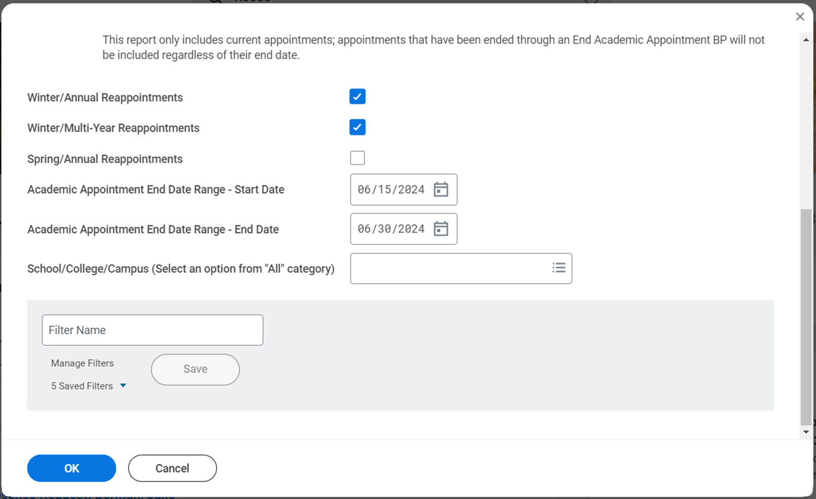
SELECTING REPORT CRITERIA
Choose your
school
Hit OK

Slide 21
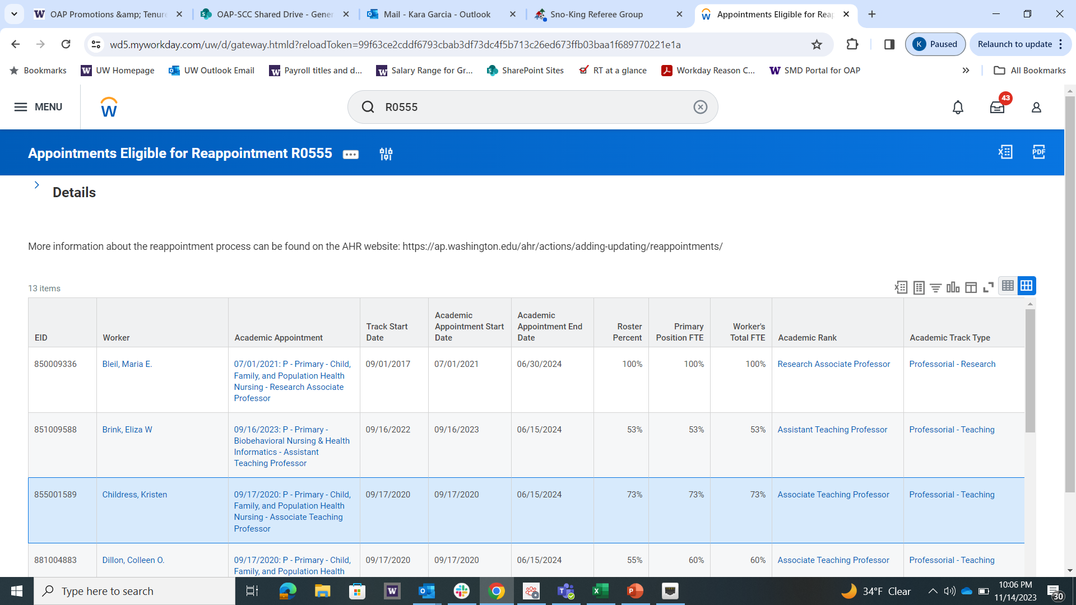
SAMPLE REAPPOINTMENT SPREADSHEET
Download and Save Excel File

Slide 22
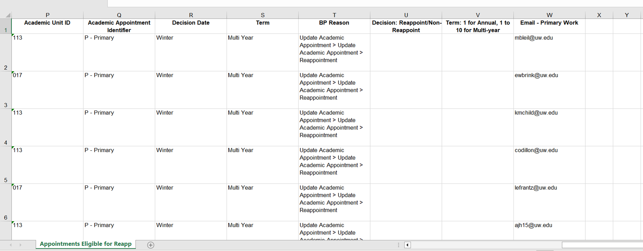
ADDING DECISIONS TO R0555

Slide 23
TIPS
Do not modify the spreadsheet. Any additions/corrections need to finalized in Workday before re-running R0555.
Only record “Reappoint/Non-Reappoint” and number of term years
Run and submit Winter and Spring reports separately
Only send one Winter and Spring spreadsheet per school/college/campus
Send the final spreadsheet to AHR close to the due date so decisions are as final as possible
Notes:
Spreadsheet has important formatting necessary for correct processing.
Rows added to the spreadsheets will not load correctly
When sending completed spreadsheets to AHR, please send only ONE spreadsheet from your school/college/campus dean’s office which includes the decisions for all departments.

Slide 24
MANUAL ENTRY

Slide 25
UNIT MANAGED TITLES
Quarterly appointments
Lecturers part-time temporary
Postdoctoral scholars*
Residents and fellows*
Visiting scholars & scientists*
Librarians
*Reappointment dates do not need to align with academic calendar
Clinical non-salaried & Affiliate:
Only academic appointments updated centrally
Position and compensation updated at the local level
Notes:
Visiting academic staff = manual
Visiting faculty (prof) = Spring
UW SoM GME office for Resident & Fellow EIB

Slide 26
MANUAL ENTRY: QUARTERLY
Quarterly Appointments (Reappointment may occur on a quarterly basis)
Artist in residence for two quarters or less
Lecturer part-time temporary for two quarters or less
Teaching associate for two quarters or less
Notes:
Such as…. Not a complete list. Managed in unit through the year

Slide 27
MANUAL ENTRY: FALLOUTS
Fallouts - If an ISC submitted “reappoint” action cannot be centrally processed in Workday, units need to manually enter it
If included on Winter/Spring spreadsheets, no additional documents need to be uploaded

Slide 28
CLINICAL NON-SALARIED & AFFILIATE
Only Appointment extensions for clinical non-salaried and affiliate titles will be centrally uploaded to Workday
Updates to paid positions and compensation need to be entered manually by unit administrators. This includes:
Extending position and compensation end dates
Lateral moves from paid to unpaid academic
Notes:
If changes to paid status (paid/unpaid) = manually at unit
If Unpaid Academic continuing = no updates needed

Slide 29
WORKDAY BUSINESS PROCESSES
Update Academic Appointment > Update Academic Appointment > Reappointment
Change Job > Data Change > 02 – Reappointment (Academic Only)
Compensation > Base Pay Change > Extend Compensation Actual End Date
Maintain Worker Documents – Upload Reappointment Letter

Slide 30
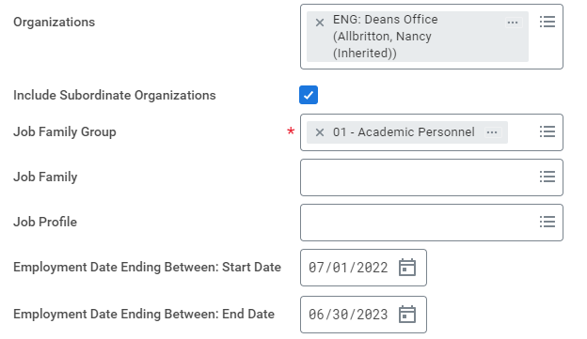
R0321: Upcoming End Employment Dates
Run to identify position end dates for:
clinical/affiliate faculty currently in paid status
emeritus and visiting faculty whose positions need to be manually reappointed
Notes:
Timelines: Due to Academic HR by

Slide 31
NON-REAPPOINTMENT

Slide 32
NON-REAPPOINTMENT
All non-reappointment actions must be confirmed in writing and entered manually in Workday
Issue Non-Reappointment letter by deadline
Record Non-Reappoint on Winter/Spring Spreadsheet
Action Item: Terminate Employee > Separation > Fixed Term Job Ended (Do NOT use the “Involuntary” reason code)
Action Item: End Academic Appointment Track > End Academic Appointment > End of Term Appointment
Notes:
The submission of the completed spreadsheet fulfills the obligation to notify AHR of reappointment decision and no additional documents are required.
However, units need to notify the faculty member of non-reappoint 30 days before the end of their current appointment end date.
Make sure to end not only the position but the academic appointment and visa versa
Terminating does not require documentation into workday – the spreadsheet again is documentation enough.

Slide 33
NON-REAPPOINTMENT: NOTES
If academic personnel has appointment(s) in another unit, coordinate to ensure correct configuration in Workday
Non-Reappointment in your unit, retaining active appointment in another unit
Coordinate transfer into the other unit
Academic personnel does not have a position in your unit
Only end the academic appointment
Do not implement termination

Slide 34
REAPPOINTMENTS W/ CHANGES
Written acknowledgement from the appointee is needed in the following circumstances:
Change in appointment period
Change of supervisor
Change in general duties/responsibilities
Change in FTE

Slide 35
RESOURCES
Reappointment instructions
Faculty Code Section 24
Sextant
UW Provost Lecturer Appointment Guidelines
Workday user guides
Service periods
AHR Contacts
Notes:
Pause on this screen for people to take photos of the links
Could also mention that this would be good one to capture.

Slide 36
Q&A
Does the faculty vote on a recommendation for the term length?
The faculty are only voting on the reappointment action. The reappointment term length is determined by the chair, and whether that happens before or after the vote is up to the unit to decide.
When are the automatic uploads done?
Generally, within four weeks of the deadlines.
When the code states the dean/chancellor provides notification of a decision, is it possible for that notification to come from an associate dean?
If the authority has been delegated from the dean to the associate dean, then yes.

Slide 37
Q&A
What if someone isn’t on the spreadsheet who we expect to be?
You should check Workday to make sure the person’s end date is correct. The R0555 report is generated based on academic appointment end dates, so if a person you expect to be on the report is not accounted for, it is likely that their end date in Workday is incorrect. DO NOT add people to the report.
Does the FTE for a reappointment need to be static?
Yes. There are circumstances where FTE can temporarily be adjusted, but contracted FTE should not be changed.

Slide 38
IMPACTS!
Carefully managed reappointments establish solid foundation for several downstream processes
Notes:
Hiatus process impact: If someone is not reappointed correctly or for the period in which is intended, eligibility for summer hiatus can be impacted and result in benefit loss over the summer months for 9 month faculty
Merit process: if someone is not reappointed correctly or for the period in which is intended, the faculty member may not be reflected/listed/reviewed as eligible for merit
Pay/Benefits/System Access: if someone is not reappointed correctly or for the period intended, the faculty member’s status may be pay impacting (under/over), loss in benefits status, and ended in workday resulting in loss of access to UW systems
Census/Reporting: if someone is not reappointed correctly, it will produce inaccurate reporting for the annual census process which then is reflected in UW reporting on faculty data for the university

Slide 39
THANK YOU!

