Slide 1
J-1 EXCHANGE VISITORS
International Scholars Operations
December 03, 2025

Slide 2

TODAY’S TOPICS
Introduction to J-1 visas
UW sponsorship requirements
Appointment details
Funding
J-1 eligibility requirements
English proficiency requirement
Health insurance requirement
Cultural exchange requirement
J-1 procedures
Q&A

Slide 3
INTRODUCTION TO J-1 VISAS

Slide 4

WHAT IS THE J-1 EXCHANGE VISITOR PROGRAM?
Key Aspects
Established in 1961
Around 300,000 participants every year
Administered by U.S. Department of State
Uses the Student and Exchange Visitor Information System (SEVIS)
Mission
To increase mutual understanding between people of the United States and people of other countries by means of educational and cultural exchanges, thereby strengthening the ties between the nations.

Slide 5
DETAILS OF J-1 STATUS
Sponsor-, activity-, and location- specific
Full-time activity only
Temporary appointments only
Period of stay can be a few days up to five years
12 & 24 month bars on certain categories
Two-year home residence requirement (possible)
Can be paid for outside “occasional lectures and short-term consultations” (only if authorized by ISO in advance)

Slide 6

Permitted Activities
J-1 exchange visitors may engage in:
Research
Observation
Consultation
Limited teaching
Demonstrating special skills
The J visa is not a work permit.

Slide 7
J-1 CATEGORIES SPONSORED BY ISO
Research Scholar/Professor Up to 5 years but 12- and 24-month bars on repeat participation
Short-Term Scholar Up to 6 months
Specialist Up to 12 months; by exception only
Notes:
But note that other J-1 categories are sponsored by ISS and IELP

Slide 8
UW SPONSORSHIP REQUIREMENTS

Slide 9
APPOINTMENT DETAILS
UW sponsors the following titles for J-1 status:
Visiting titles
Postdoctoral Scholar
Acting Instructor & Acting Assistant Professor
Artist in Residence
Other titles by exception, at unit request
Appointments must be full-time and have regular UW faculty sponsor supervision.
UW cannot sponsor tenured or tenure-track faculty as J-1 exchange visitors.

Slide 10

FUNDING REQUIREMENTS
There are two funding requirements:
UW J-1 funding minimum
UW salary minimum
Meeting the J-1 Funding Minimum
Scholar has enough money to support themselves and their family in the U.S.
Meeting the Salary Minimum
UW or another source is compensating the scholar at an appropriate level for the appointment title

Slide 11
J-1 FUNDING MINIMUM
UW Funding Minimum (applies regardless of title or salary source)
$2,500/month for the J-1 exchange visitor
$1,200/month for the J-2 spouse
$600/month for each J-2 child
Funding Source
At least 50% of funding minimum must come from a source other than personal or family funds.
Notes:
J-1s must meet these minimum thresholds

Slide 12
UW SALARY SCHEDULE
For most titles, the J-1 will also have to show outside funding equivalent to the UW salary minimum for their title and rank.
Outside funding can include one or more government, employer, UW, or third-party sources. Personal or family funds do not count.
As courtesy titles, visiting scholars are not subject to the UW salary minimum. However, they still have to meet the J-1 funding minimum.

Slide 13
FUNDING AND SALARY EXAMPLES
 | Example 1 | Example 2 | Example 3
Title | Visiting Scholar | Postdoctoral Scholar | Visiting Associate Professor (nine-month)
Spouse? | Y | N | Y
Children? | 3 | 0 | 1
Annual J-1 Funding Minimum | $66,000 | $30,000 | $51,600
Annual Salary Minimum | (none) | $68,460 | $67,050
Notes:
If scholar has a large family, the funding floor may be more than the UW salary schedule

Slide 14
HOW TO DOCUMENT FUNDING
Funding documentation must:
Come from the funding source
Be signed and on letterhead
Be written in English
Include the scholar’s name
Include the sponsorship dates
Include the exact funding amount in U.S. dollars
ISO will review funding documentation and contact you if it does not match or otherwise meet these requirements. Feel free to reach out to us with questions!

Slide 15
J-1 ELIGIBILITY REQUIREMENTS
English proficiency
Health insurance
Cultural exchange

Slide 16
J-1 ENGLISH PROFICIENCY
J-1 Exchange Program sponsors are required to confirm that prospective scholars have “sufficient proficiency in the English language […] to successfully participate in his or her program and to function on a day-to-day basis.”
That proficiency must be determined by an objective measurement of English language.

Slide 17
OBJECTIVE ENGLISH PROFICIENCY MEASUREMENTS
Acceptable methods for documenting English proficiency:
A recognized English language test
Signed documentation from an academic institution or English language school
A documented interview conducted by the sponsor
Units must use one of these three methods to confirm proficiency before submitting the visa request.

Slide 18
RECOGNIZED ENGLISH LANGUAGE TEST
Units should retain a test result copy with exchange visitor’s name.
Pass/fail test: Exchange visitor must have passed. (E.g.: Cambridge English)
Scored test: The unit can decide necessary score. (E.g.: TOEFL)
Online or informal tests are not acceptable.
Units may choose to use the UW Admissions requirements for English proficiency.

Slide 19
ACADEMIC INSTITUTION OR ENGLISH LANGUAGE SCHOOL REQUIREMENTS
Units should retain a signed document on school/institutional letterhead including:
The exchange visitor’s name
Their proficiency level
Dates of attendance
Basis for proficiency assessment (e.g. completion of English coursework)
Notes:
Simply submitting a diploma from an institution doesn’t suffice. They must have documentation that statues their proficiency level.

Slide 20
DOCUMENTED ENGLISH PROFICIENCY INTERVIEW
How and when can the interview take place?
Must be in-person or video if possible
If neither is possible, a phone interview may be used
The interview must be conducted before the J-1 visa request is submitted to ISO
The interview must be conducted by a UW employee, preferably the faculty sponsor or the unit administrator, who is proficient in English.

Slide 21
PROFICIENCY INTERVIEW (CONTINUED)
Resulting documentation should include:
Participant names
Interview date, time, and method
Assessment method (e.g. was a rubric or scoring method used)
Statement that scholar is sufficiently proficient in English
Signed and dated by interviewer
ISO offers an interview documentation template that you can use!
Notes:
Include details about how assessment was made – e.g. did you understand everything the scholar said? Grammar? Etc.

Slide 22
PROFICIENCY INTERVIEW (CONTINUED)
Informal assessment: The interviewer can discuss life in the U.S., e.g.:
Where do you think you’ll want to live?
What support services are you interested in?
Tell me about what you like to do outside of work.
What do you think will be most challenging about living and working in the U.S.?
If the visitor can’t answer these questions clearly and completely, they’re probably not proficient enough for daily life in the U.S.
Formal assessment: The interviewer can use the TOEFL Scoring Rubric or another proficiency rubric of their choice.

Slide 23
INSURANCE REQUIREMENT
J-1 exchange visitors must obtain and maintain the following insurance requirements throughout their stay:
Health insurance
Medical repatriation
Evacuation insurance
Benefit | Required amount
Medical benefits | $100,000 minimum
Deductible per accident or illness | $500 maximum
Repatriation of remains | $25,000 minimum
Medical evacuation | $50,000 minimum
ISO collects the Insurance Compliance Form at check-in and with all J-1 extensions.
Notes:
UW insurance plans do not include repatriation of remains or medical evacuation insurance

Slide 24
CULTURAL EXCHANGE REQUIREMENT
All sponsors must have cultural exchange plans in place for the J-1 and J-2(s)
For possible activities, see:
Our cultural exchange page
CIRCLE
The Whole U
FIUTS
Visiting Seattle (City of Seattle website)
State of Washington Tourism (nonprofit website)

Slide 25
Q&A - English Proficiency
Q: If the visitor has demonstrated English proficiency via an accepted test, but the interviewer doesn't feel confident to provide their own sign-off for English proficiency, what should we do? If they are not as proficient as hoped, is it up to the discretion of the academic unit? Is it enough that they have colleagues in the department who speak the same language?
A: If they have an accepted language proficiency test that shows they are proficient in English, then that’s sufficient to demonstrate ability.
If the scholar has gone through an interview and the interviewer isn’t confident in the scholar’s language ability, you need to seriously consider what additional language support would be necessary for the exchange visitor to be able to function in the exchange program and in day-to-day life, and whether you’re willing to provide it. There are rare cases where units provide a translator for scholars with lower proficiency.
In general, the intent of this requirement is to ensure that the scholar can communicate well enough in English to function both in and outside of work environments during their program. It isn’t sufficient that everyone in the lab speaks the same language unless they are also supporting the scholar with their English communication skills in day-to-day life.

Slide 26
Q&A – Cultural Exchange
Q: If our cultural exchange plans have changed temporarily due to financial stability measures, but we intend to return to normal operations when possible, do we need to revise our cultural exchange plans document for now?
A: You can amend your cultural exchange plans on the conditional approval; we can even update this and recirculate it for signatures at your request. It is also OK if cultural plans change slightly due to funding or are adjusted based on the financial constraints of the department. The important thing is that there are plans in place to have the scholar engage in some cultural activities in order to meet the regulatory requirement.

Slide 27
J-1 PROCEDURES

Slide 28
PREPARING THE J VISA REQUEST
Start at least three months before the start date
Review How to Sponsor a J-1 Exchange Visitor page
Collect scholar information using J Visa Intake Form
Verify and retain evidence of funding from all sources
Document scholar’s English proficiency
Plan cultural exchange activities for the scholar and their family

Slide 29
SUBMITTING THE J VISA REQUEST
Submit J Visa Request to ISO and pay CTI fee(s)
Note: Units may NOT recover the CTI fees from J-1 postdoctoral scholars
Provide signed visa request, with supporting documentation, to ISO
After the DS-2019 has been issued, submit a J1 Amendment Form for any changes in:
Sponsorship dates
Biographical information
Other changes

Slide 30
SUPPORTING DOCUMENTATION
Supporting documentation includes but is not limited to:
Copies of passport biographic pages for J-1 and all J-2 dependents
The offer, invitation, or reappointment letter
Funding documentation
Documentation of English proficiency
Patient care letter for foreign medical graduates
See J-1 Required Documents for more detail.

Slide 31
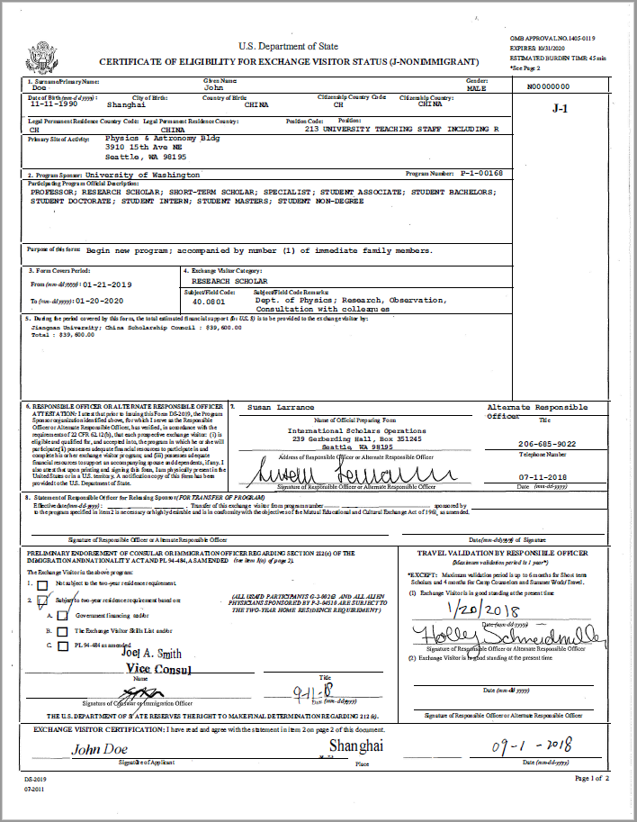
DS-2019 CERTIFICATE OF ELIGIBILITY
ISO uploads digital DS-2019 to Manage Files section of visa request
Department downloads and forwards DS-2019 to exchange visitor
Exchange visitor prints DS-2019 (double-sided) and uses it to apply for J visa at consulate. Uses DS-2019 and visa stamp to enter U.S.
Let ISO know if arrival is delayed by using our J-1 Amendment Form and we can amend the dates on the DS-2019.
Notes:
Printed 2-sided copy of electronic DS-2019 is a valid document. Send hard copy to scholar if they do not have access to a printer. Since 01/01/2025, ISO no longer provides hardcopies of DS-2019s to units (only digital copies are distributed via Lux or RT).

Slide 32
EXCHANGE VISITOR RESPONSIBILITIES
Pay $220 SEVIS fee and other visa application fees
But note: units must reimburse the $220 SEVIS fee for postdoctoral scholars
Submit remote check-in request form to ISO within 30 days of start date
Maintain health insurance in compliance with federal law
Avoid unauthorized employment
Seek permission from ISO before engaging in “occasional lectures and consultations”
Leave the U.S. within the 30-day grace period

Slide 33
EXCHANGE VISITOR RESPONSIBILITIES (CONTINUED)
J-1 exchange visitors must report changes to ISO:
Late arrival in U.S. (unit admins please use our Amendment Form)
Changes in address or contact information (scholars use this form)
Early departure of either J-1 or J-2 (by emailing acadvisa@uw.edu)

Slide 34
SPONSOR RESPONSIBILITIES (POST-ARRIVAL)
Make sure scholar does not start work before start date on DS-2019
Help scholar settle in (Husky card, NetID, housing…)
Ensure the scholar completes Mandatory Remote J-1 Check-In requirement
Provide cultural exchange opportunities
Email acadvisa@uw.edu in advance of: early departures, changes in worksite, title, funding, research focus or duties, leave of absence, resignation, etc.
Notify ISO immediately of any significant incidents involving the scholar: injuries, deaths, lawsuits, arrests, investigations, document loss or theft, etc.
Extend the scholar’s stay in a timely manner
Notes:
TALK ABOUT REMOTE CHECK-INS. Will talk more about incident reporting.

Slide 35
REPORTING REQUIREMENTS - J-1 INCIDENTS
UW must report the following incidents to the Department of State:
Death, disappearance, or serious injury or illness of the exchange visitor
Incidents involving the criminal justice system, or sexually-related incidents or abuse
Serious behavioral problems or mental health concerns surrounding the exchange visitor
Incidents involving child protective services
Fraud (e.g., visa, immigration, or financial fraud or scam)
Please report any such incidents to ISO at acadvisa@uw.edu as soon as possible.
Notes:
Report to ISO even if you are not sure it’s a “reportable” incident.

Slide 36
REPORTING REQUIREMENTS – J-1 INCIDENTS (CONTINUED)
UW must report the following incidents to the Department of State:
Unsuitable host/work conditions (e.g., incident or allegation involving workplace bullying, harassment, discrimination, hostile work environment, or work hours and/or wage-related issues)
Negative press involving the J-1 program, or incidents where a foreign government has become involved
Lost or stolen immigration documents
Theft of intellectual property, or violation of export controls
Other situations impacting exchange visitor safety
Please report any such incidents to ISO at acadvisa@uw.edu as soon as possible.

Slide 37
REPORTING REQUIREMENTS - ABSENCES
Absences from U.S. of 30+ days should be reported to ISO if scholar has:
Approved International Remote Work Request from the Office of Global Affairs, or
Approved protected leave request from UWHR
All changes and/or incidents can be emailed to ISO at acadvisa@uw.edu.

Slide 38
TRANSFER PROCEDURES
Transferring to UW:
Unit must submit a new J Visa Request and a copy or scan of the exchange visitor’s current DS-2019
ISO will contact the current program sponsor to arrange the transfer
Transferring from UW:
Exchange visitor must submit a Transfer Verification Form to ISO
ISO will contact the new program sponsor to arrange the transfer
Notes:
As with any J visa Request, submit at least 3 months ahead of transfer date

Slide 39
LEAVING THE U.S.
Grace period
Exchange visitors have up to 30 days after the DS-2019 end date to leave the U.S.
If they leave during the grace period, no notice to ISO is necessary.
Leaving before DS-2019 end date
Report departure to ISO so that the DS-2019 can be updated.
Please encourage your exchange visitors to complete our J-1 Scholar Exit Interview form before leaving the U.S.!
Notes:
Cannot work during grace period

Slide 40
Q&A – How UW uses J-1 visas
Q: Is ISO considering expanding use of the J-1 visa in cases where H-1B would have been used in the past, given the new $100,000 fee?
A: Yes, ISO considers J-1 visas one potential pathway, but some other visa types may be a better fit depending on the position and the scholar’s personal immigration history. There is some overlap between how we can use J-1 and H-1B visas, but they’re not completely interchangeable; most scholars can’t easily just come on J-1 instead of an H-1B, and clinical patient care and tenured or tenure-track positions aren’t allowed on the J-1 visa.

Slide 41

For further questions:
Contact us: acadvisa@uw.edu
For more resources, visit:
https://ap.washington.edu/ahr/visas/admin-resources/j1/
Notes:
Training Archives page link: https://ap.washington.edu/ahr/resources/training-archive/

