Slide 1
New APF Required Training for Faculty Search Committees – Admin Session
Chadwick Allen, UW APF Inclusive Excellence
Joyce Yen, UW ADVANCE Center for Institutional Change, UW APF Inclusive Excellence
Comail Rizvi, UW APF Inclusive Excellence
Notes:
Run of Show:
90-minute training

Slide 2
Hiring Training Context

Slide 3
Hiring Training at UW
Required
Optional (APF)
20-minute UWHR Workday Learning training for hiring authorities
  Self-paced, available July 1
  Certification good for 1 year
90-minute APF live training for faculty search committees
  Offered year-round and on demand
  Certification good for 3 years
Preparing for Faculty Hiring (Spring)
Effective Practices for Interviewing (Fall)
Custom Workshops (on demand)
Interfolio Admin Companion Sessions
Office Hours / Consultations

Slide 4
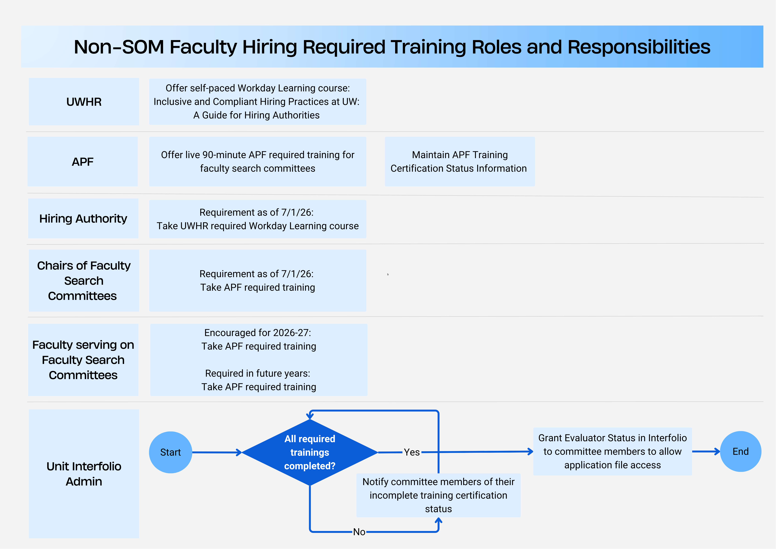
Non-SOM Faculty Hiring Required Training Roles and Responsibilities

Slide 5
How to check training status
(UWHR requirement)
All required training complete?
Learning Coordinator Role in Workday
  Learning Enrollment Report R0098
    Learning Course Field → Under “Topic” Select “Compliance” → Select “Inclusive Hiring Practices”
Workday employee look up
  Employee → Career → Learning

Slide 6
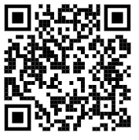
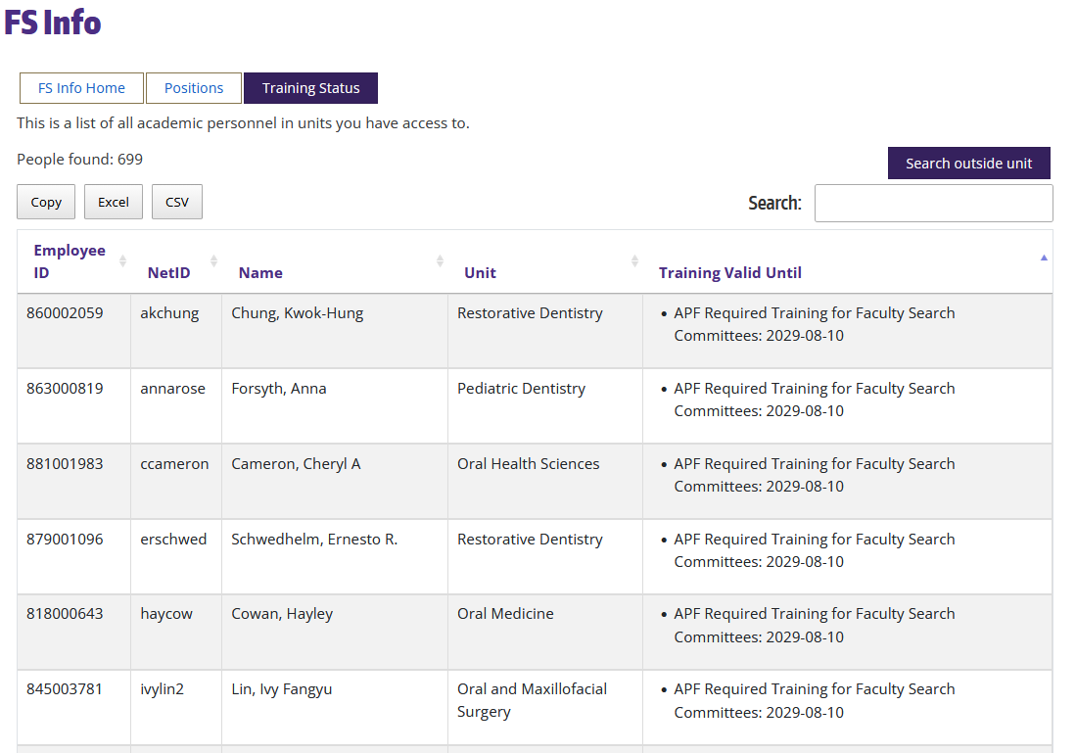
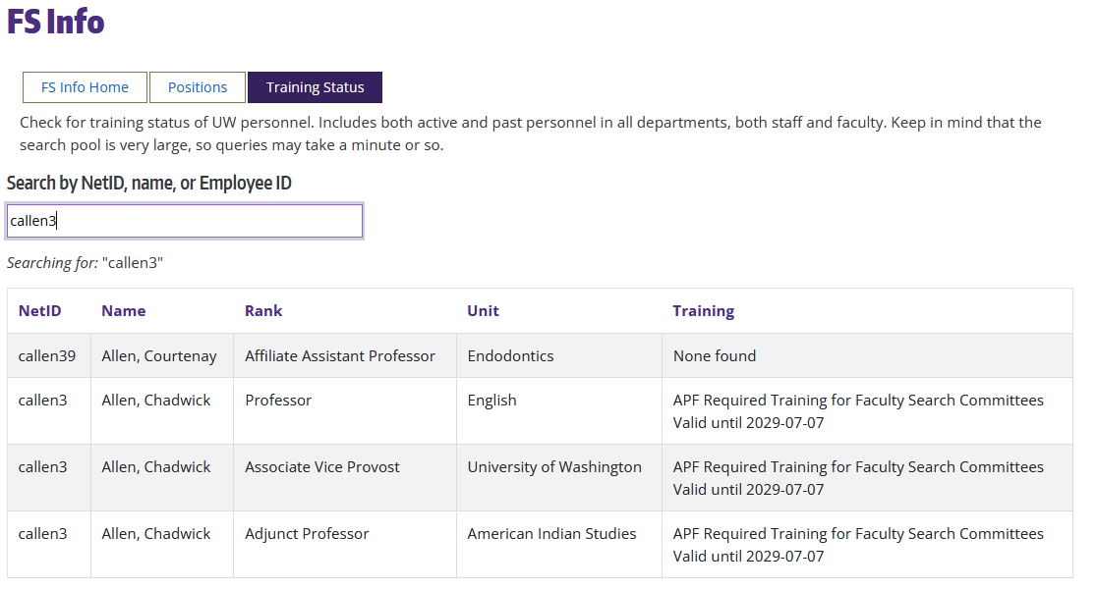
How to check training status
(APF requirement)
All required training complete?
Email APF IE at facadv@uw.edu
APF System – Faculty Search Information (FS Info)
  Go to https://ap.washington.edu/fs-info and click on Training Status

Slide 7
Certification Steps for APF Training
Take the check-in survey at the start of the training
Attend the full 90-minute training
Take the check-out survey at the end of the training
Granting Evaluator status in Interfolio:
Level 1: Committee Chair Access
Level 2: Committee Member Access
Level 3: General Faculty Access

Slide 8
APF IE: facadv@uw.edu
Chadwick Allen
Associate Vice Provost
Office for Academic Personnel and Faculty callen3@uw.edu
Joyce Yen
Director
ADVANCE Center for Institutional Change joyceyen@uw.edu

